Slide 1
QXU4004 Eng. Chemistry
Dr Sulafudin Vukusic s.vukusic@qmul.ac.uk

Slide 2
Weeks 9 and 10
Electronegativity and Dipole Moment

Slide 3
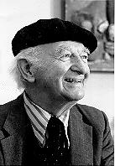
Electronegativity is defined as the ability of an atom in a molecule to attract electrons to itself
Electronegativity is a function of two properties of
isolated atoms;
The atom’s ionization energy (how strongly an atom holds onto its own electrons)
The atom’s electron affinity (how strongly the atom attracts other electrons)
For example, an element which has: A large (negative) electron affinity
A high ionization (always endothermic, or
positive for neutral atoms)
Prof. Linus Pauling
Nobel Prize for Chemistry 1954
Nobel Prize for Peace 1962
Will: Attract electrons from other atoms and Resist having electrons attracted away
Such atoms will be highly electronegative

Slide 4
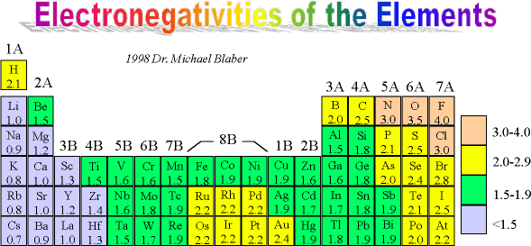
Pauling scale of electronegativity;
Fluorine is the most electronegative element followed by O and N, Cl are
equal third. Cs is least.
Electronegativity increases from left to right along the Periodic Table. For the representative elements (s & p block), the electronegativity decreases as you go down a group.
No trend in the transition metals.

Slide 5
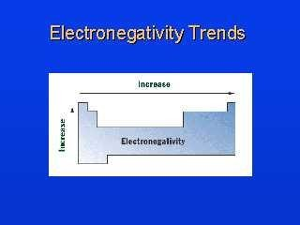

Slide 6
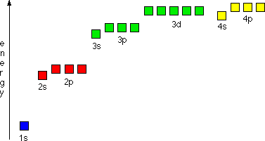
Electronegativity is dictated by:
The number of protons in the nucleus
across a period you are increasing the number of protons, but filling electrons in the same Bohr quantized energy level. You are only filling sub-shells, so electronegativity increases from left to right
The distance from the nucleus
down groups, you are placing electrons into new quantized energy levels, so moving further away from the attractive power of the nucleus. Outer shell becomes further away from the nucleus.
The amount of screening by the inner electrons
level of screening upon bonding electrons increases down groups, and adds to the reduction in
electronegativity. Screening is caused by repulsion of electrons for each other.
In hydrogen atom, energy of orbital depends on the principle quantum number, n.
But in many electron atoms, electron- repulsions cause different sub-shells to have different energies,
Sub-shell energy increases (with
increasing l) s < p < d

Slide 7
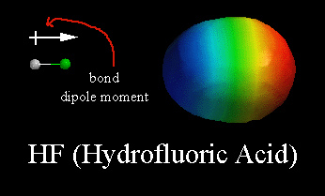
The three major types of intramolecular bond can be described by
the electronegativity difference:
Non-Polar Covalent – Bonds which occur between atoms with little or no electronegativity difference (less than 0.5).
Polar Covalent – Bonds which occur between atoms with a definite electronegativity difference (between 0.5 and 2.0).
Ionic – Bonds which occur between atoms with a large electronegativity difference (2.0 or greater), where electron transfer
can occur.
E.g.
F-F (4.0 – 4.0 = 0) is non-polar covalent
H-F (4.0 – 2.1 = 1.9) is polar covalent
LiF (4.0 – 1.0 = 3.0) is ionic
δ+
δ-
H F

Slide 8
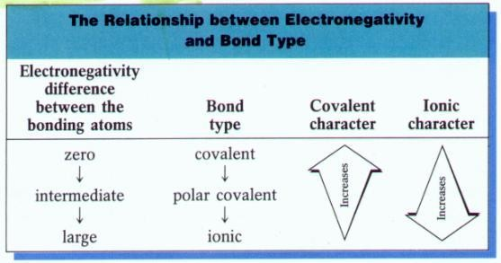


Slide 9
Dipole Moment occurs in any polar covalent bond, because of an unequal sharing of the electron pair between two atoms
E.g. Which of the following bonds is most polar: S-Cl, S-Br, Se-Cl or Se-Br?
S-Cl (3.0 – 2.5) = 0.5
S-Br (2.8-2.5) = 0.3
Se-Cl (3.0-2.4) = 0.6
Se-Br (2.8-2.4) = 0.4
Therefore, Se-Cl is the most polar!
We should be able to reach the same conclusion using the Periodic Table,
Cl is furthest to the right and to the top of the Periodic Table, so is the most electronegative. Se is furthest to the left (‘metallic like’) and towards the bottom. Therefore, difference in electronegativity should be the greatest!

Slide 10
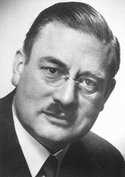
Dipole Moment: µ = Qr
Dipole moment is defined as the magnitude of charge (Q) multiplied by the distance (r) between the charges;
units are D (Debye) = 3.36 x 10⁻³⁰ C.m
Prof. Peter Debye Noble Prize 1936
Compound | Bond Length (Å) | Electronegativity Difference | Dipole Moment (D)
H-F | I 0.92 N | 1.9 ^{I} N | 1.82 ^{I} N
H-Cl | C 1.27 R | 0.9 ^{C} R | 1.08 ^{C} R
H-Br | E 1.41 ^{A} S | 0.7 ^{E} A | 0.82 ^{E} A
H-I | 1.61 ^{E} | 0.4 ^{S} E | 0.44 ^{S} E
D E C R E A S E
Although the bond length is increasing, the dipole is decreasing as you move down the halogen group. The electronegativity decreases as we move down the group. Thus, the greater influence is the electronegativity of the two atoms (which influences the charge at the ends of the dipole).

Slide 11
µ = Qr = 1.6 x 10⁻¹⁹ C x (1 x 10⁻¹⁰ m) = 1.6 x 10⁻²⁹ C.m
When proton & electron 100 pm apart, the dipole moment is 4.80 D
µ = Qr = 1.6 x 10⁻²⁹ C.m x (1D / 3.36 x 10⁻³⁰ C.m) = 4.8 D
4.8 D is a key reference value! It represents a pure charge of
+1 and -1, which are 100 pm (100pm = 1Å= 10⁻¹⁰ m) apart. The bond is said to be 100% ionic!
If the charge separation were increased or decreased then the dipole moment increases or decreases linearly
If charges of +1 and -1 were separated by 120 pm
µ = 120/100 (4.8 D) = 5.76 D
If charges of +1 and -1 were separated by 50 pm µ = 50/100 (4.8 D) = 2.4 D

Slide 12
Calculating % of ionic character in a polar bond
(100pm = 1Å)
H-F; µ = 1.82 D (measured)
If 100% ionic,
µ = 92/100 (4.8 D) = 4.42 D
bond length = 0.92 Å (92 pm)
% ionic = 1.82/4.42 x 100 = 41 % ionic
H-Cl; µ = 1.08 D (measured)
If 100% ionic,
µ = 127/100 (4.8 D) = 6.10 D
bond length = 1.27 Å (127 pm)
% ionic = 1.08/6.10 x 100 = 18 % ionic
H-Br; µ = 0.82 D (measured) If 100% ionic,
µ = 141/100 (4.8 D) = 6.77 D
bond length = 1.41 Å (141 pm)
% ionic = 0.82/6.77 x 100 = 12 % ionic

Slide 13
Polar Molecules = Molecules with permanent dipole
moments
HCl has only one covalent bond (which is polar). Therefore, its dipole moment = H-Cl bond dipole
In a molecule with two or more polar bonds, each bond has a dipole moment contribution = bond dipole
Net dipole moment = vector sum of its bond dipoles
O C O
Linear Molecules: CO₂ is Non-polar
Net dipole = 0
Because CO₂ dipoles are orientated in opposite directions. The dipoles have equal magnitudes; they cancel

Slide 14
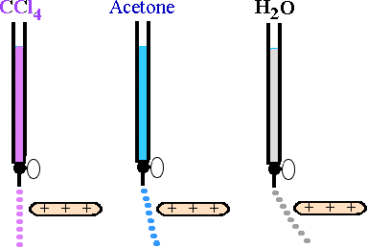
Symmetrical molecules (e.g. CCl₄, CH₄) are non-polar. The four dipoles are of equal magnitude and neutralize one another at the center of a tetrahedron
Non-symmetrical molecules (e.g. CHCl₃, CO(CH₃)₂, H₂O) are Polar. The dipoles are not all equal or in opposite directions (partial charges and bond lengths are all different in C-Cl, C-H, C=O, C-H)
(H₂O is a bent molecule not linear, see later notes)

Slide 15
Formal Charges: the number of valence electrons in the isolated atom minus the number of electrons assigned to the atom in the Lewis structure. These are not real charges, but help with keeping count of electrons in Lewis structures.
E.g. CN⁻
_
Number of valence electrons = 9 + 1 =10
C N
4-5 = -1
5 - 5 = 0
5 - 4 = -1
Lewis structures of Charged Molecules: Predict the most likely structure!
E.g. NCS⁻
Number of valence electrons = 15 + 1 =16
_
_
N C S
N C S N C S
1
0
+1
-1
0
0
0
-1
-2
0
Structure 1 is preferred because the lowest values of formal charges AND
the negative charge is on the most electronegative atom.

